Slide 1
Xenophobia & Antisemitism
Student Support & Attendance services
HUMAN RELATIONS, DIVERSITY & eQUITY
Notes:
Teacher, please feel free to encourage student participation whichever way you are most comfortable: in the Zoom chat, on a previously shared Jamboard, in break out groups, or all together in a grid view.

Slide 2
If you could solve a social justice issue, what would it be?

Slide 3
What is Xenophobia?
- Lee Scheffe
Notes:
https://youtu.be/SmwbfORMeKE (7:26)

Slide 4
What are some ways you've heard or seen about different people being treated lately?
Do you know anyone who has been judged because of COVID-19?
Notes:
Script:
Introduce the term scapegoating
Since March 2020, Asian people have been repeatedly targeted and blamed for the Coronavirus.
They have been spit on, screamed at, and beaten.

Slide 5
“Whenever there is some kind of major incident with global or regional implications, and as soon as you can identify it in relation to some racial ’other,’ particularly in predominantly, multi-ethnic societies like England and the U.S., I think it’s very easy for people to use a very small excuse to start scapegoating.”
Miri Song, Professor of Sociology
University of Kent
Notes:
Explain more about scapegoating

Slide 6
Antisemitism

Slide 7
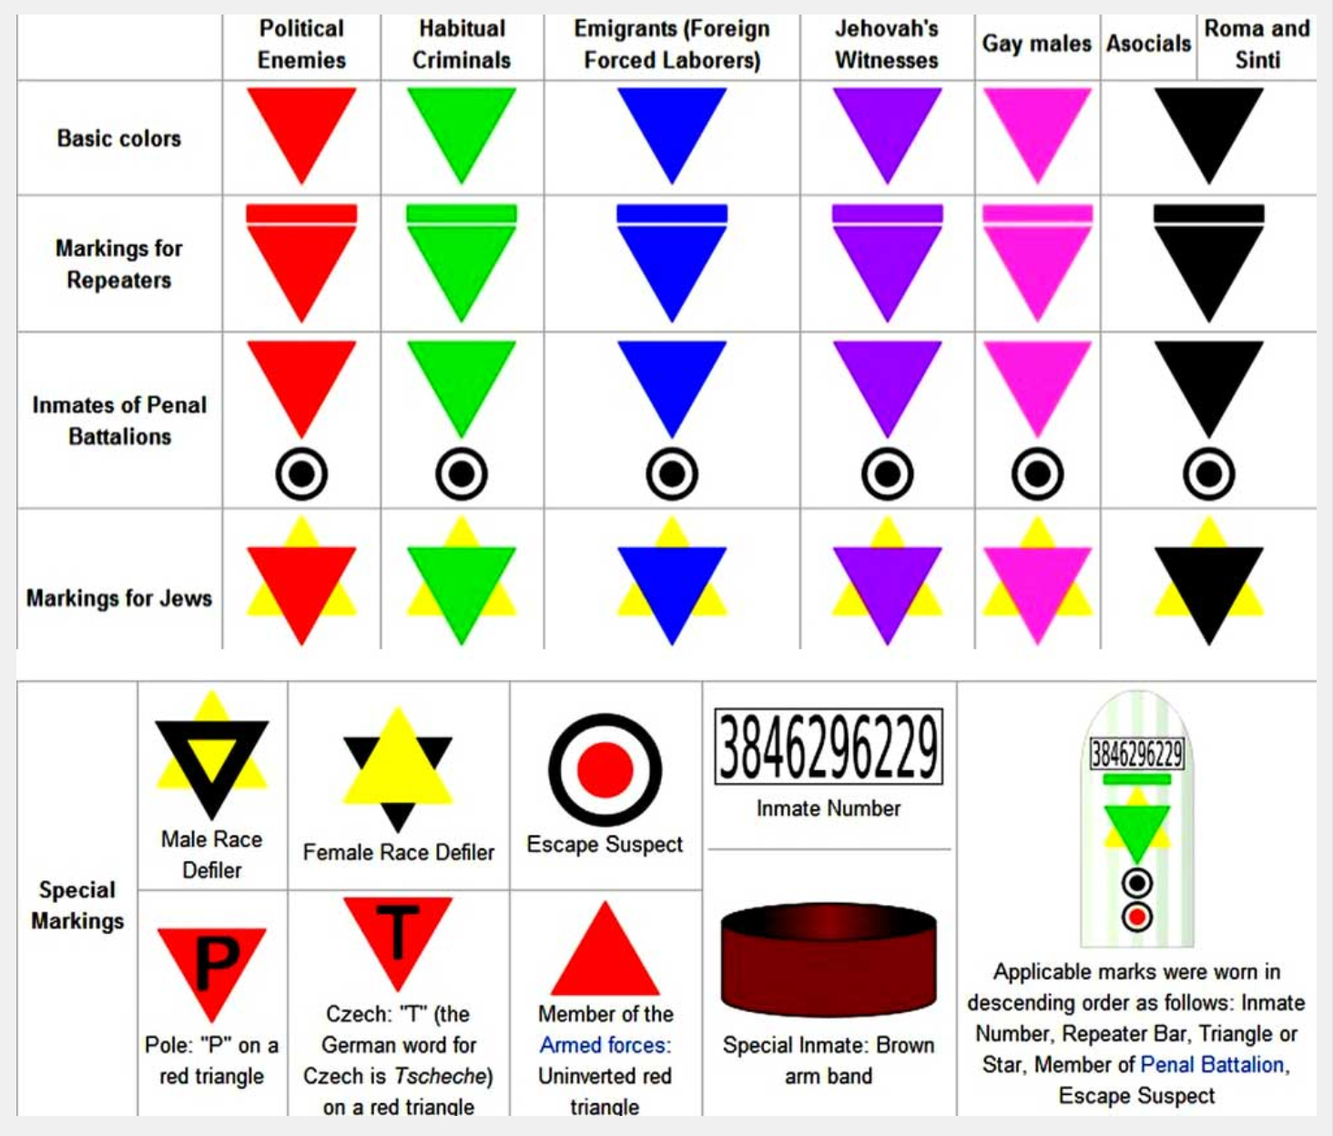
antisemitism
Antisemitism is prejudice against or hatred toward Jews.
The Holocaust, the persecution and murder of European Jews by Nazi Germany and its collaborators between 1933 and 1945, is history’s most extreme act of antisemitism.
Led by Adolf Hitler, the Nazi party killed 6 million Jews and 5 million non-Jews during the Holocaust.
Everyone in the camp was identified using the symbols on the chart.

Slide 8
Antisemitism today
Notes:
https://youtu.be/KJ1bLhdnHCk (4:27)

Slide 9
In the video, the 3 students share different experiences of antisemitism they have experienced in the present day.
How prevalent do you think antisemitism is in your school, community, society?

Slide 10
What can you do?
Get
the facts
Challenge
information that is blaming of a particular group of people
Get
to know people of other cultures
Be
aware of where the information is coming from

Slide 11
What will you do?
name 3 things that you can do to challenge xenophobia and antisemitism?

Slide 12
Human relations, diversity & equity https://www.lausd.org/human-relations

Slide 13
Teacher feedback
Notes:
Teacher please take a brief feedback survey by scanning the QR code or using the link below.
https://forms.office.com/r/i9UqyyxzTT

